Slide 1
Social Media Template Guide
How to upload your logo to graphics
Go to Insert > Pictures > This Device
Select your file and upload
Place your logo on the top left corner, inline with Nviro’s logo. Remove the grey box
Select your logo and press Ctrl+C then click on a different slide and press Ctrl+V to add your logo to other graphics
How to export the graphics to use on your social media pages
The social media graphics are shown on slides 3-7. Click on the slide that you wish to export.
Go to File > Export > Change File Type > PNG Portable Network Graphics Select a file to save the image then press Save and select Just This One Slide
Where to find the written content for posts
Select one of the graphic slides and click on Notes at the bottom:
You can then copy and paste the words, along with uploading the relevant graphic to your social media page when creating a post

Slide 2
Don’t forget to tag us in your posts!
You can find Nviro on Facebook, LinkedIn and Twitter:
@nvirocleaning
Nviro Limited
@nvirocleaning

Slide 3
Insert logo here
Flush the toilet thoroughly
Put paper towels in the bin
Only flush pee, poo and paper
Keep the floor dry and tidy
Notes:
By keeping our washrooms tidy, we can help our cleaning teams be more efficient in delivering a clean, hygienic and safe environment for our students and staff to thrive in while saving on costs.
How can we keep washrooms tidy? ✅ Flushing toilets thoroughly ✅ Putting paper towels in bins ✅ Only flushing pee, poo, and paper in toilets ✅ Keeping the floor dry and tidy
Learn more about the benefits of housekeeping in schools 👇
http://ow.ly/62uK50M3oQf
#cleaningupdate #cleaningsolution #education #schools #housekeeping #nviro

Slide 4
Insert logo here
Clear surfaces before you leave
Put rubbish in the bin
Put away used crockery
Wipe up any spills immediately
Notes:
By keeping our school areas tidy, we can help our cleaning teams be more efficient in delivering a clean, hygienic and safe environment for our students and staff while saving money.
How can we keep school areas tidy? ✅ Clearing surfaces before leaving ✅ Putting rubbish in bins ✅ Putting away used crockery ✅ Wiping up any spills immediately
Learn more about the benefits of housekeeping in schools 👇
http://ow.ly/62uK50M3oQf
#cleaningupdate #cleaningsolution #education #schools #housekeeping #nviro

Slide 5
Insert logo here
Kills bacteria, viruses and germs
Reduces sickness
Creates a healthier environment
Improves attendance
Notes:
Working in partnership with @NviroLimited, we will be applying protective coatings to all surfaces within our schools to help reduce the spread of bacteria among students and staff.
Applying protective coatings to our surfaces provides multiple benefits including:
✅ Kills bacteria, viruses, and germs ✅ Reduces sickness among students and staff ✅ Creates a healthier environment without the use of harmful chemicals ✅ Improves attendance
Find out more about the benefits of using protective schools in schools 👇
http://ow.ly/rswn50M384Q
#cleaningupdate #cleaningsolution #education #schools #protectivecoatings #nviro

Slide 6
Insert logo here
Clear desks before you leave
Put rubbish in centralised bins
Stack chairs at the end of the day
Keep floors clean and tidy
Notes:
We’re asking our students and teachers to help keep our classrooms tidy so that our cleaners can be more efficient to help us save money.
How we can keep our classrooms tidy: ✅ Clearing desks before leaving ✅ Putting rubbish in centralised bins ✅ Stacking chairs at the end of the day ✅ Keeping floors clean and tidy
Learn more about the benefits of housekeeping in schools 👇
http://ow.ly/62uK50M3oQf
#cleaningupdate #cleaningsolution #education #schools #housekeeping #nviro

Slide 7
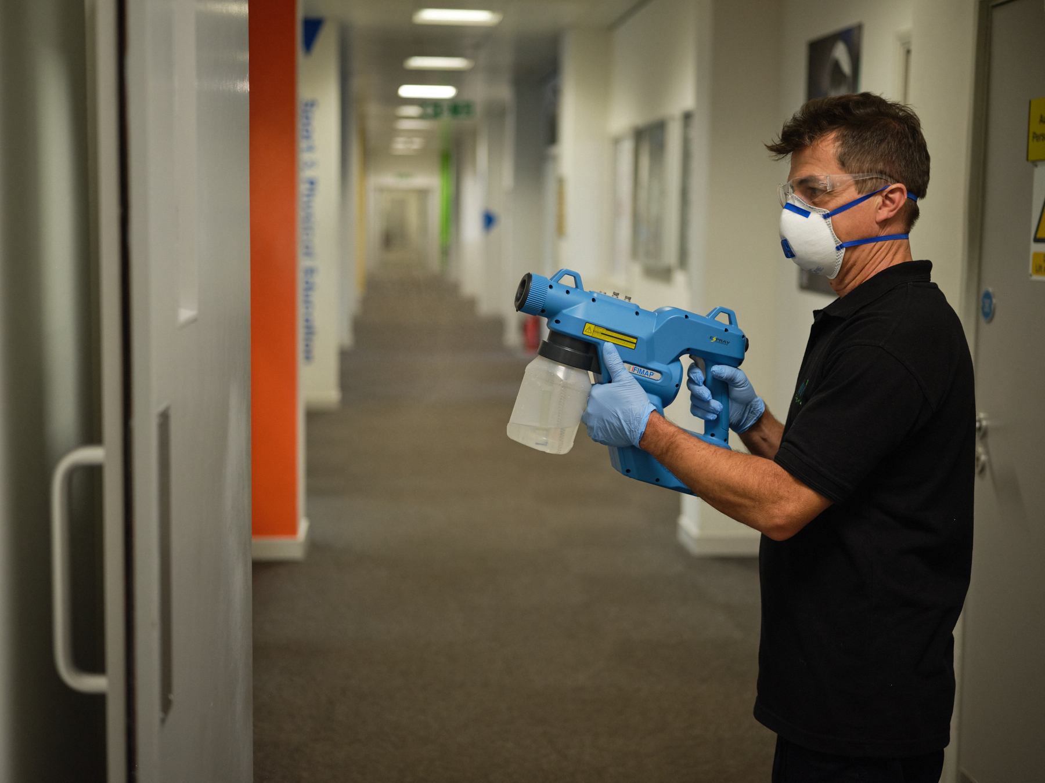
Insert logo here
Keeping our school clean, hygienic & safe with protective coatings
Notes:
Our cleaning provider, @NviroLimited has introduced a new cost-effective hygiene solution to our school which will consist of a weekly clean along with applying protective coatings to all surfaces.
Protective coatings kill bacteria, viruses, and germs, reducing sickness levels among students and staff while helping us to save money.
Find out more about the benefits of using protective coatings in schools 👇
http://ow.ly/rswn50M384Q
#cleaningupdate #cleaningsolution #education #schools #protectivecoatings

Slide 8
Insert logo here
Reduce the need for chemicals
Use less water
Produce less waste
Save energy
Notes:
How are we improving cleaning standards and benefiting the environment?
In partnership, Nviro has introduced new equipment to improve standards and help reduce the environmental impact and promote more sustainable cleaning methods.
We’ve introduced cleaning equipment which:
✅ Uses less water than a mop and bucket - Saves 31 litres of water a day (This is the same as two showers)
✅ Reduce the amount of cleaning chemicals needed to clean floors
✅ Energy efficient with less power needed for cleaning equipment
✅ Reduce the amount of waste during cleaning, such as disposable mop heads or cloths
With the introduction of new cleaning equipment, we can positively impact the environment and create a space you want to work in every day.
#cleaningupdate #cleaningsolution #education #schools #nviro

