Slide 1
Social Media Template Guide
How to upload your logo to graphics
Go to Insert > Pictures > This Device
Select your file and upload
Place your logo on the top left corner, inline with Nviro’s logo. Remove the grey box
Select your logo and press Ctrl+C then click on a different slide and press Ctrl+V to add your logo to other graphics
How to export the graphics to use on your social media pages
The social media graphics are shown on slides 3-7. Click on the slide that you wish to export.
Go to File > Export > Change File Type > PNG Portable Network Graphics Select a file to save the image then press Save and select Just This One Slide
Where to find the written content for posts
Select one of the graphic slides and click on Notes at the bottom:
You can then copy and paste the words, along with uploading the relevant graphic to your social media page when creating a post

Slide 2
Don’t forget to tag us in your posts!
You can find Nviro on Facebook, LinkedIn and Twitter:
@nvirocleaning
Nviro Limited
@nvirocleaning

Slide 3
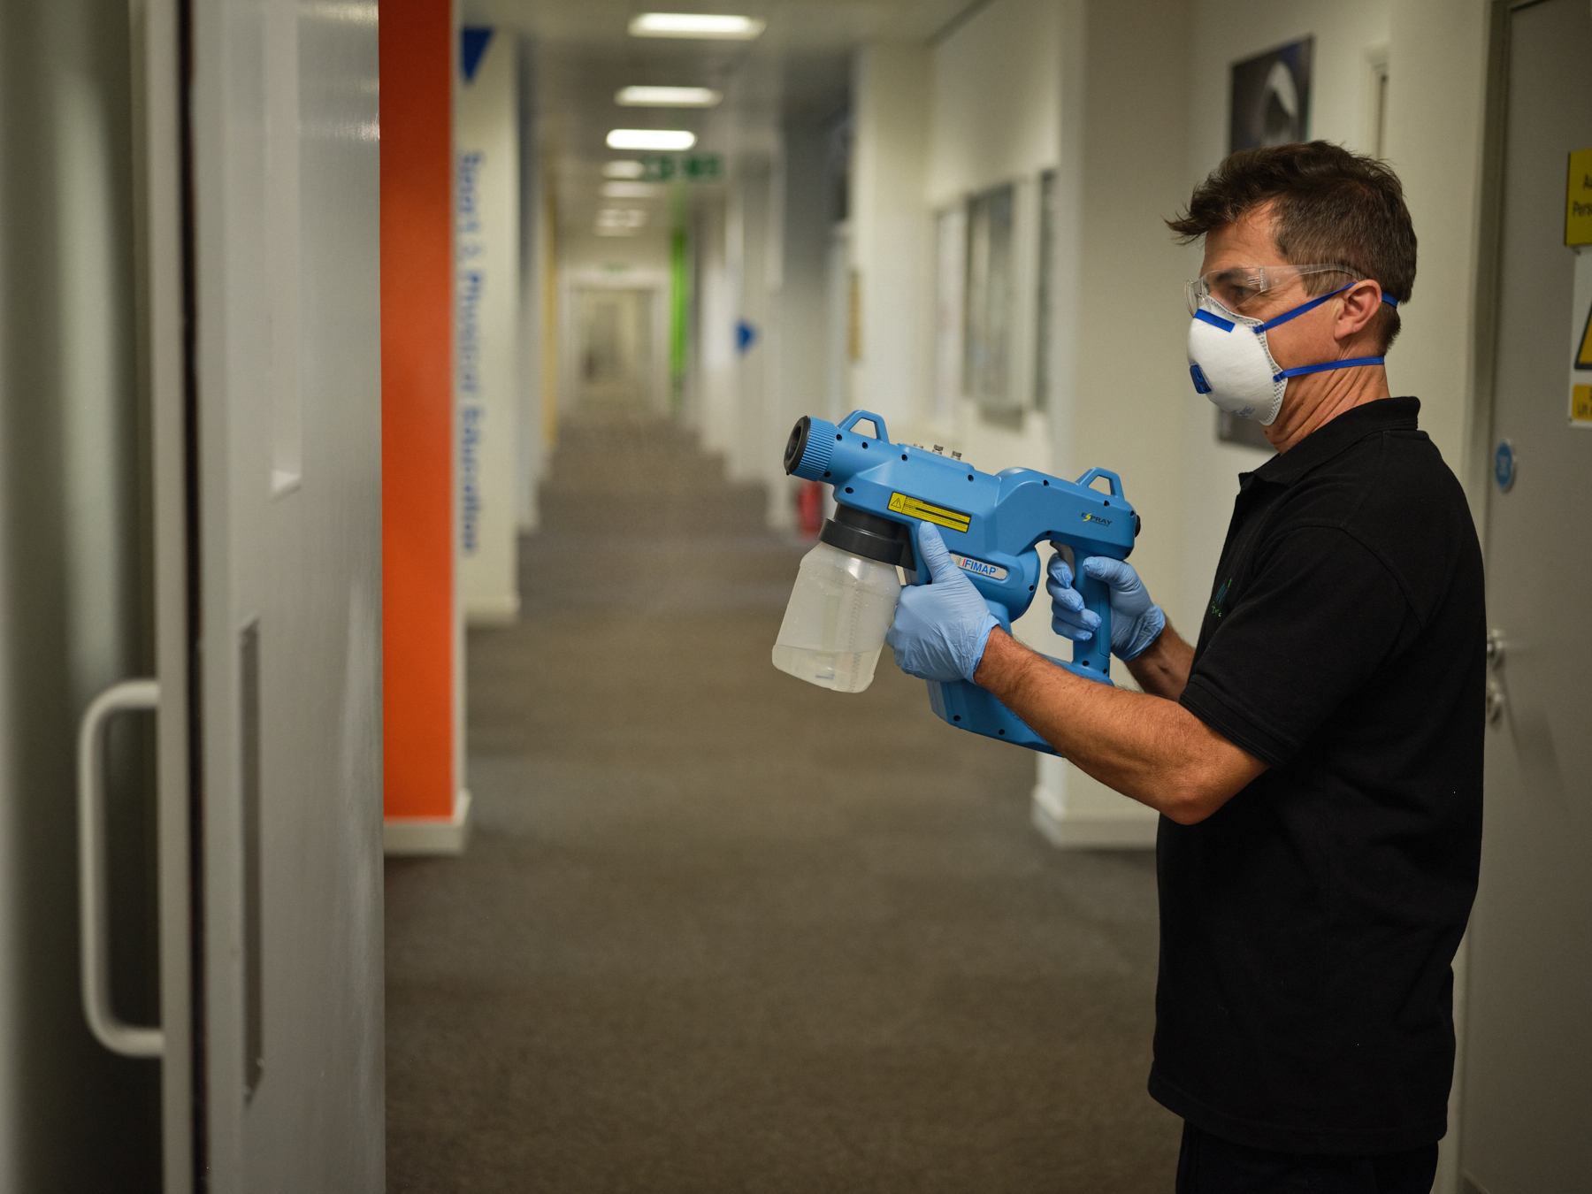
Insert logo here
Keeping our University clean, hygienic & safe
Notes:
Our cleaning provider, @NviroLimited has introduced a new hygiene solution to keep our University clean, hygienic and safe for building users to thrive in.
We will be using a surface enhancer and protective coatings on surfaces to make them easier to clean while killing bacteria, viruses and germs. Regular swab testing will also be carried out to check the hygiene levels of surfaces, helping to keep building users safe.
Find out more about the benefits of using protective coatings and surface enhancers 👇
http://ow.ly/rswn50M384Q
#cleaningupdate #cleaningsolution #education #university #protectivecoatings #nviro

Slide 4
Insert logo here
Kills bacteria, viruses and germs
Reduces sickness
Creates a healthier environment
Improves attendance
Notes:
Working in partnership with @NviroLimited, we will be applying protective coatings to all surfaces within our University to help reduce the spread of bacteria among students and staff.
Applying protective coatings to our surfaces provides multiple benefits including:
✅ Kills bacteria, viruses, and germs ✅ Reduces sickness among students and staff ✅ Creates a healthier environment without the use of harmful chemicals ✅ Improves attendance
Find out more about the benefits of using protective coatings 👇
http://ow.ly/rswn50M384Q
#cleaningupdate #cleaningsolution #education #university #protectivecoatings

Slide 5
Insert logo here
Long-term protection from contaminants
Enhances aesthetic appeal
Prolongs the life of building fabric
Easier to clean
Notes:
Working with @nviroLimited, we will be applying a surface enhancer to all surfaces within our University which provide multiple benefits including:
✅ Long-term surface protection from contaminants ✅ Enhances aesthetic appeal ✅ Easier to clean surfaces ✅ Prolongs the life of building fabric
Find out more about the benefits of using surface enhancer and protective coatings below 👇
http://ow.ly/rswn50M384Q
#cleaningupdate #cleaningsolution #education #university #protectivecoatings #surfacenehancer #nviro

Slide 6
Insert logo here
Identifies cleaning areas that can be improved
Reduces sickness
Improves attendance
Helps keep building users safe
Notes:
Working with @NviroLimited, our cleaning teams will be using swab testing to check the hygiene levels of our surfaces.
Using swab testing within our cleaning routine can provide multiple benefits including:
✅ Identifying cleaning areas that can be improved ✅ Reducing sickness levels ✅ Improving attendance levels ✅ Keeping building users safe
Find out more about how Nviro is keeping students and staff safe 👇
http://ow.ly/rswn50M384Q
#cleaningupdate #cleaningsolution #education #university #swabtesting #nviro

