Slide 1
Insert logo
Changes to the way we clean your school

Slide 2
You want your school to be clean, hygienic and safe..

Slide 3
But we also need to reduce costs as much as possible

Slide 4
Please help us keep your school tidy, so our cleaners can do their job efficiently

Slide 5
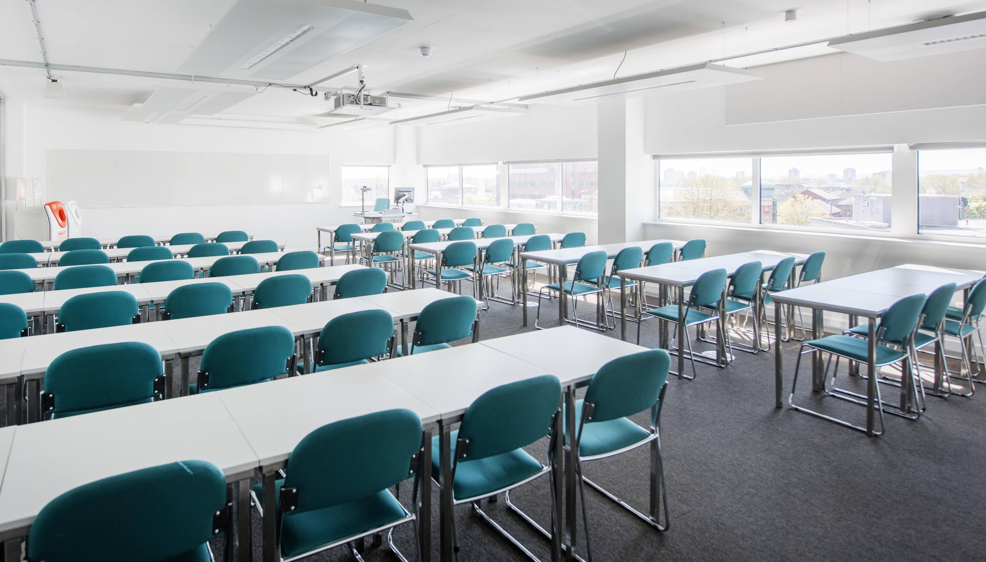
So, what’s changing?

Slide 6
We’re likely to be trying robotic vacuum cleaners..

Slide 7
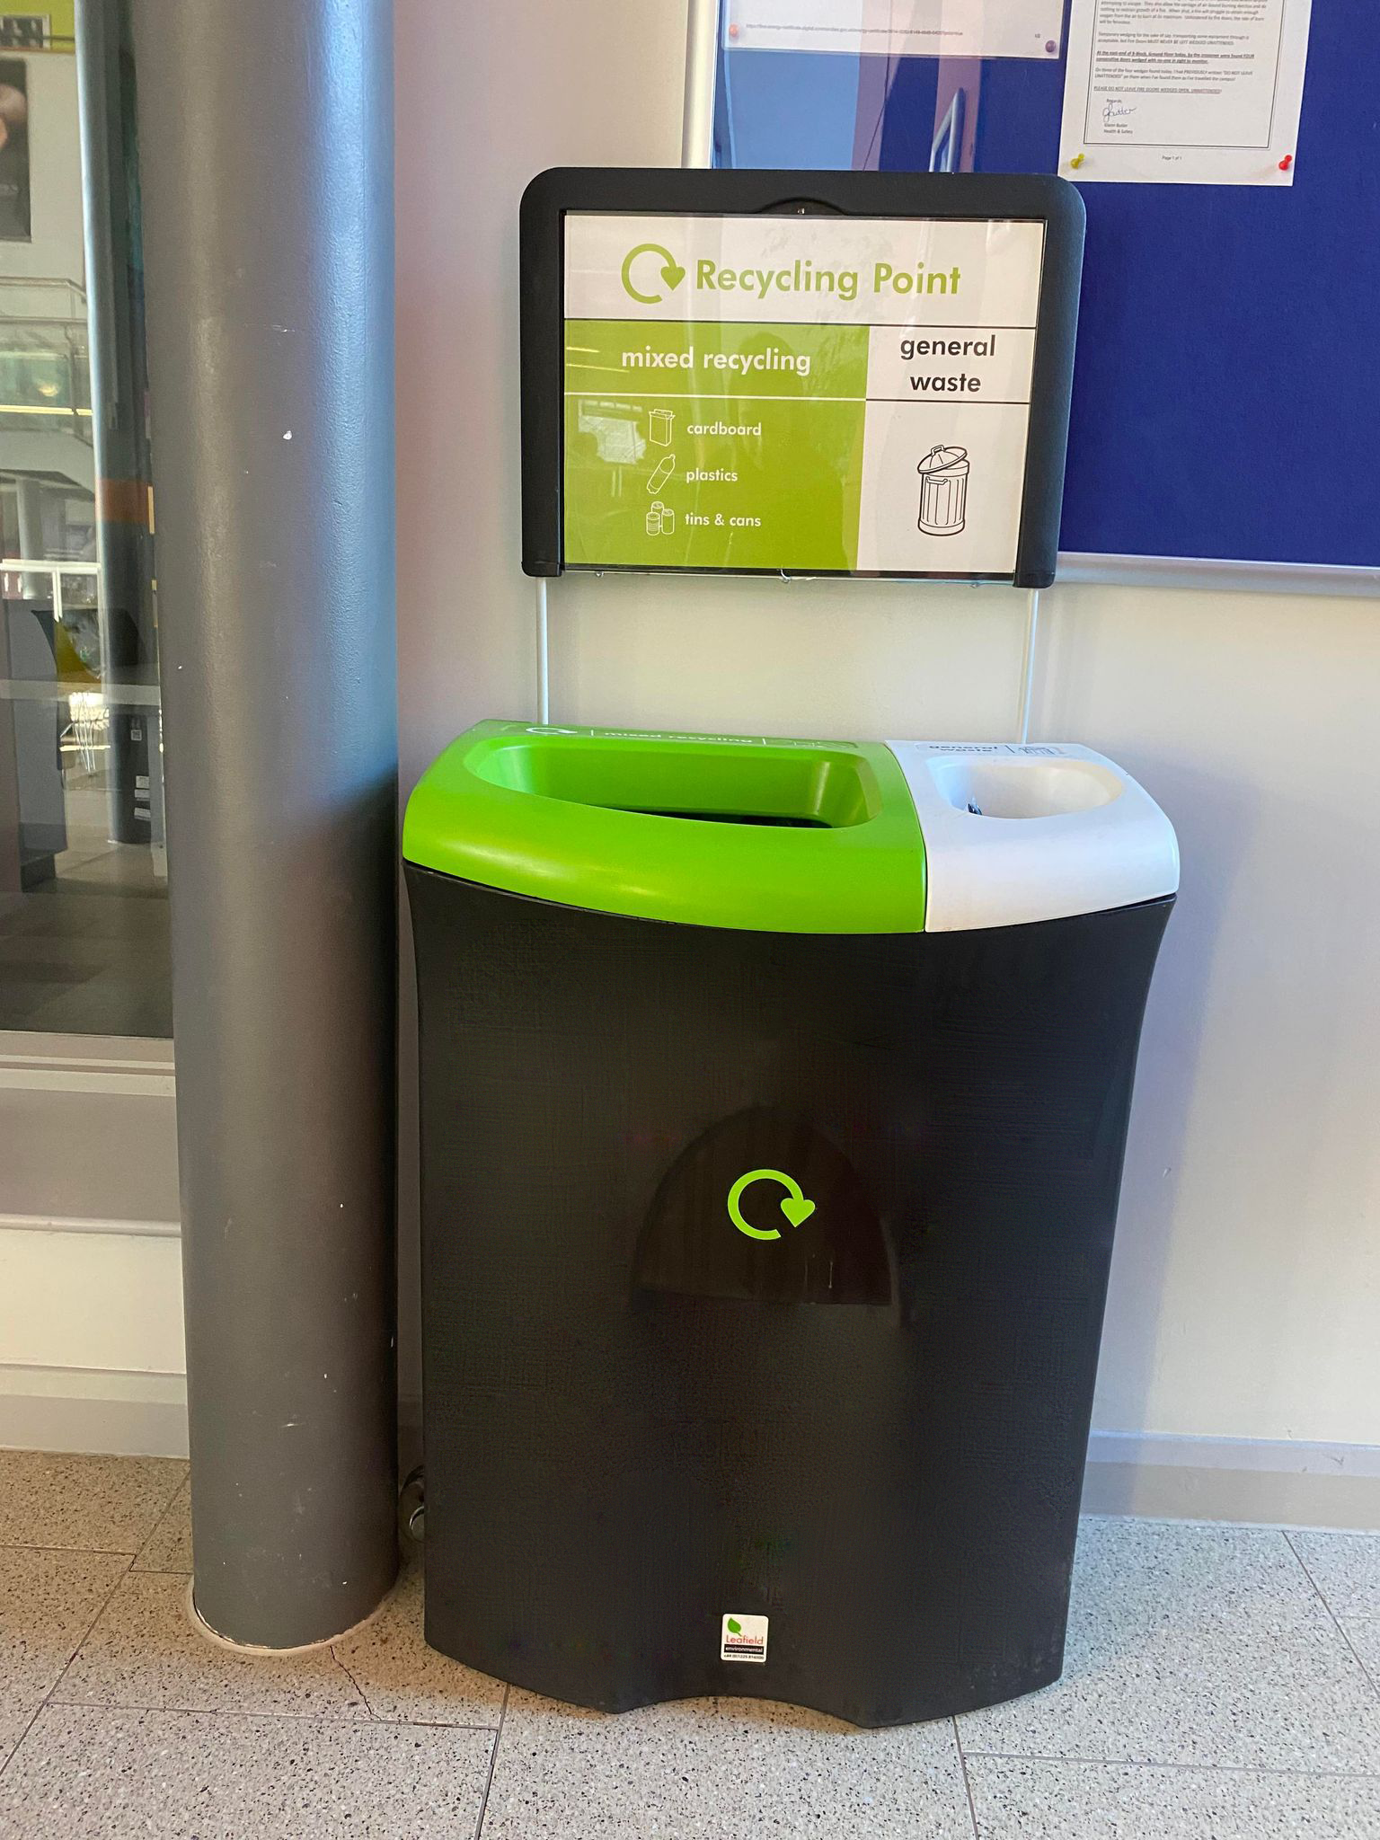
And we may also introduce a centralised binning system..

Slide 8
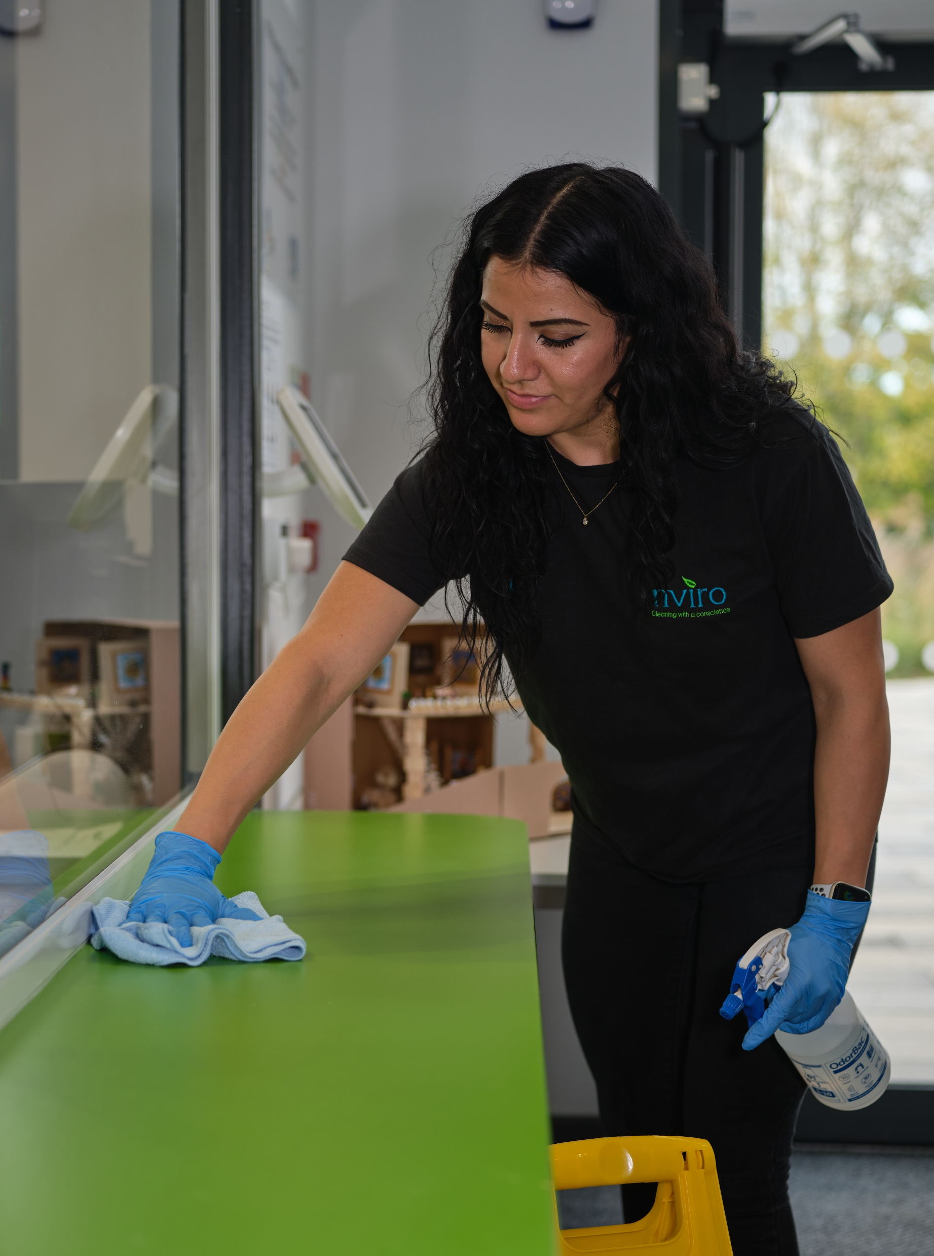
We will also be cleaning quieter areas less frequently..

Slide 9
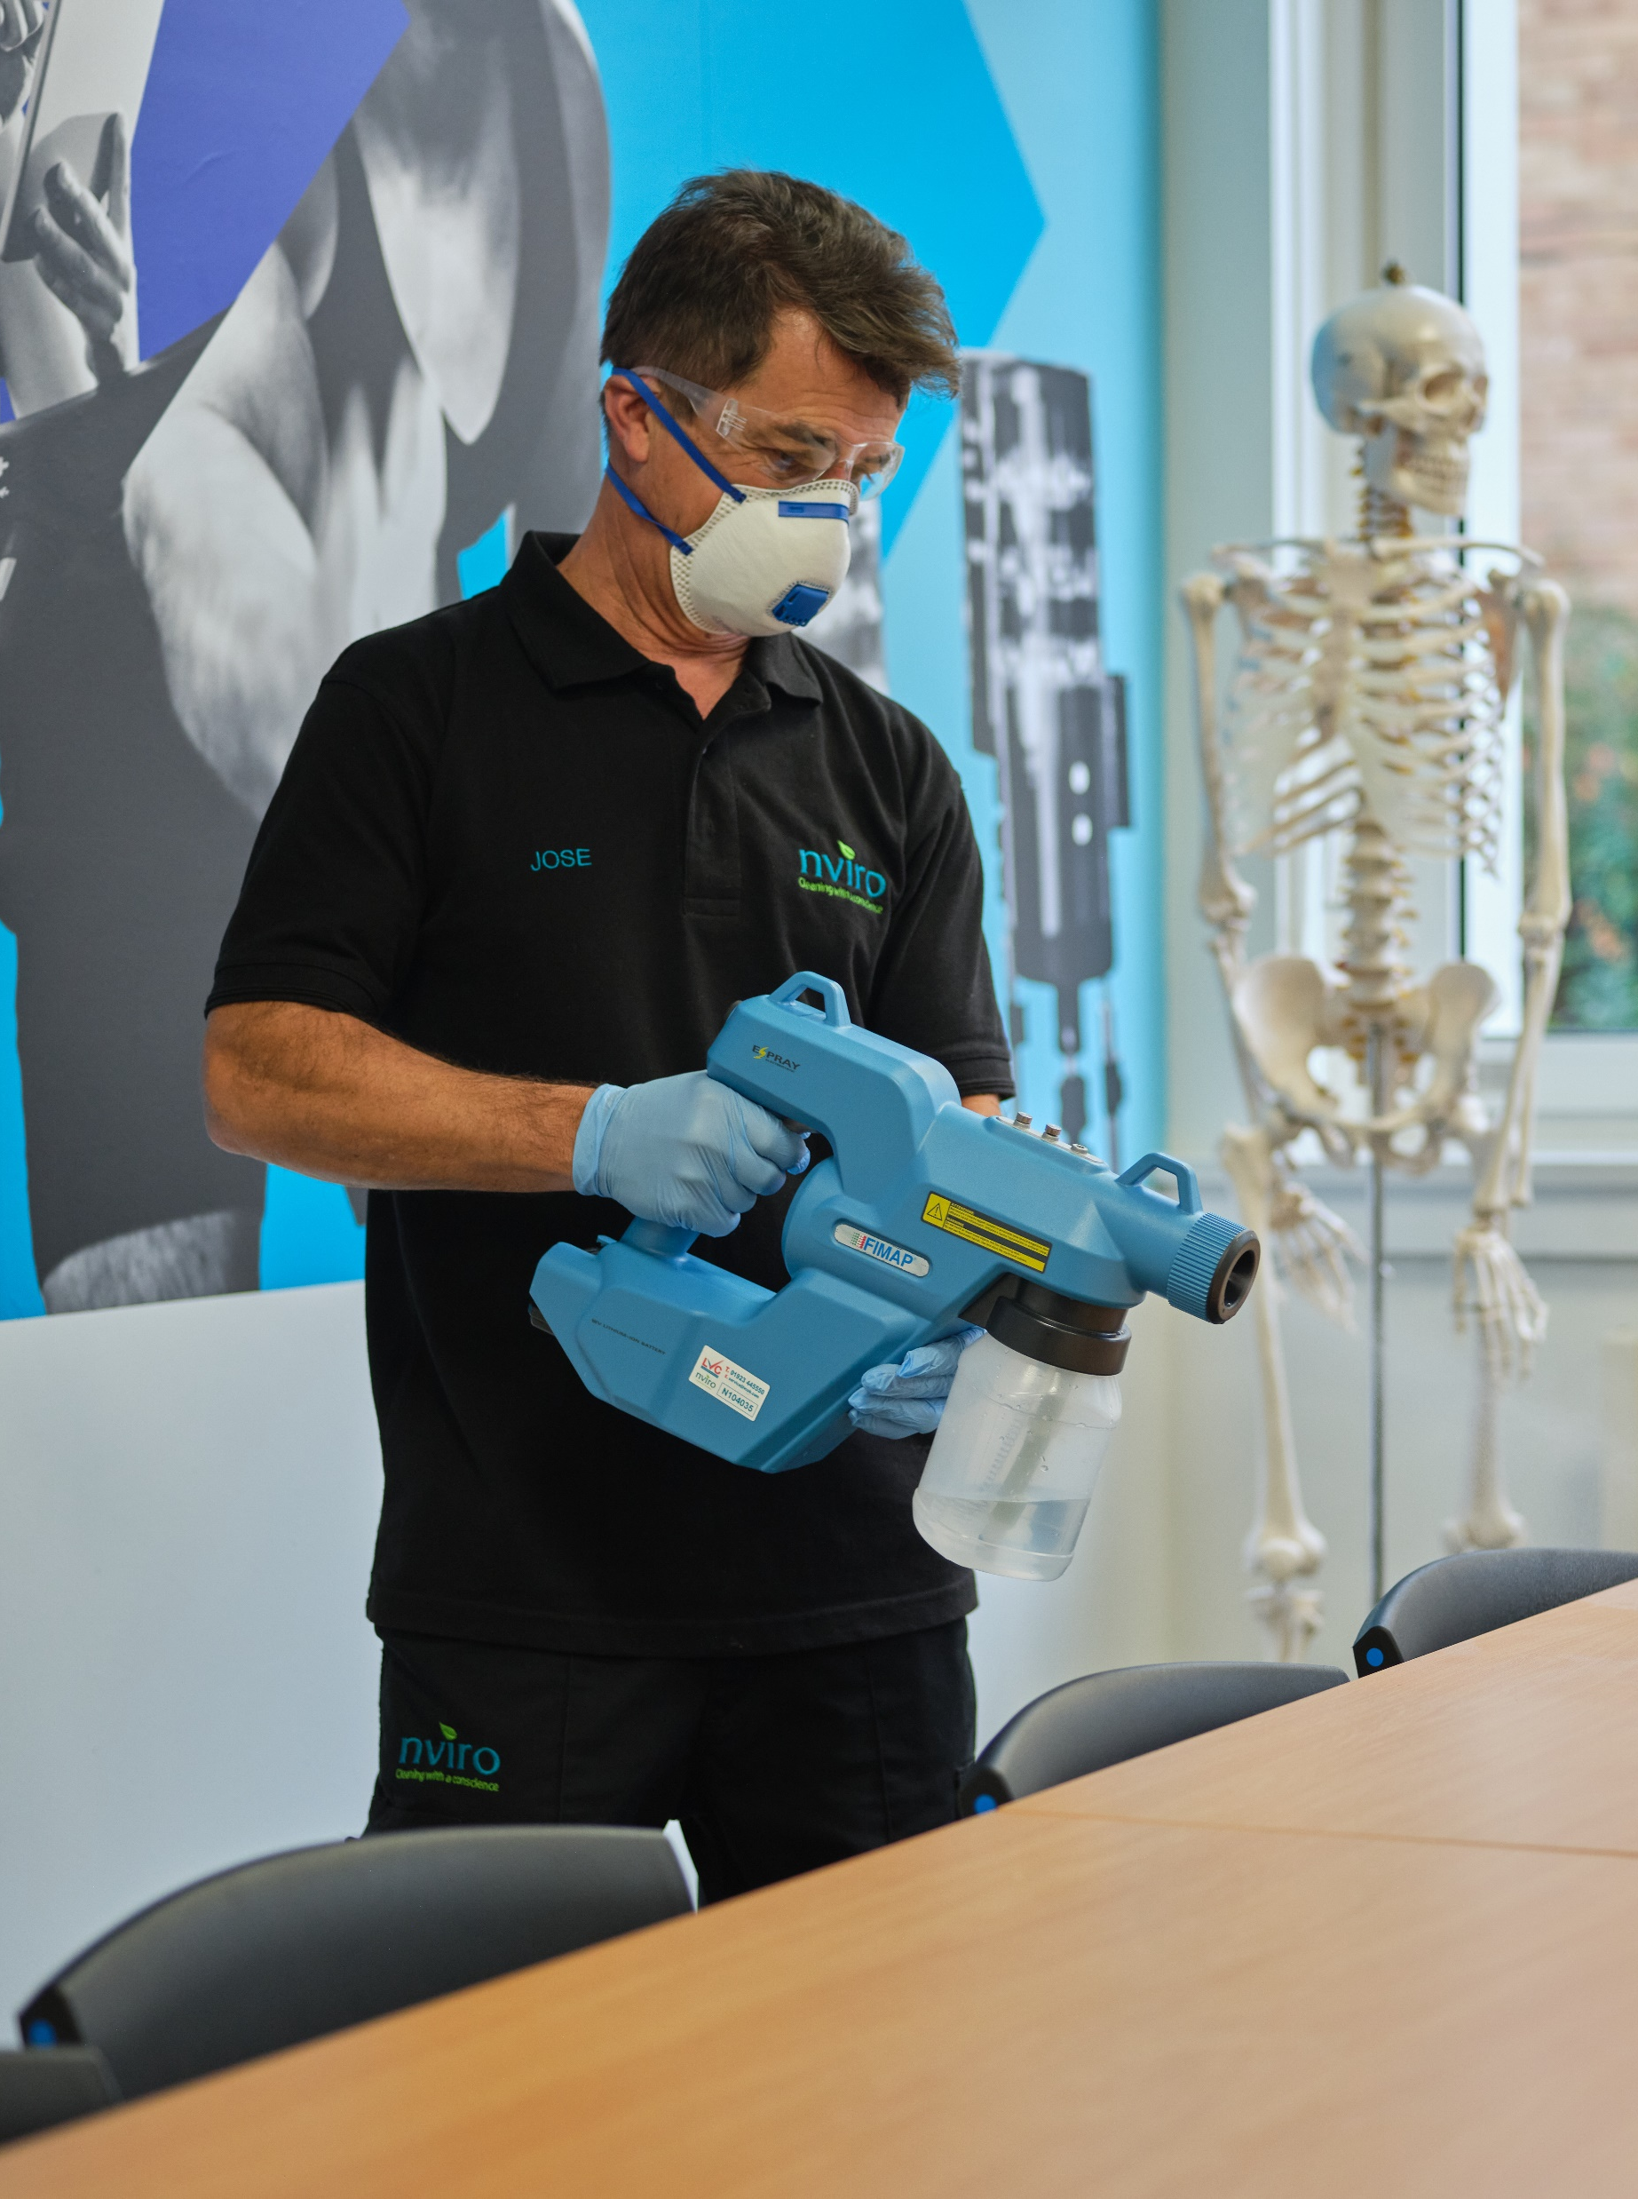
And will be using special coatings on surfaces to make them easier to keep clean..

Slide 10
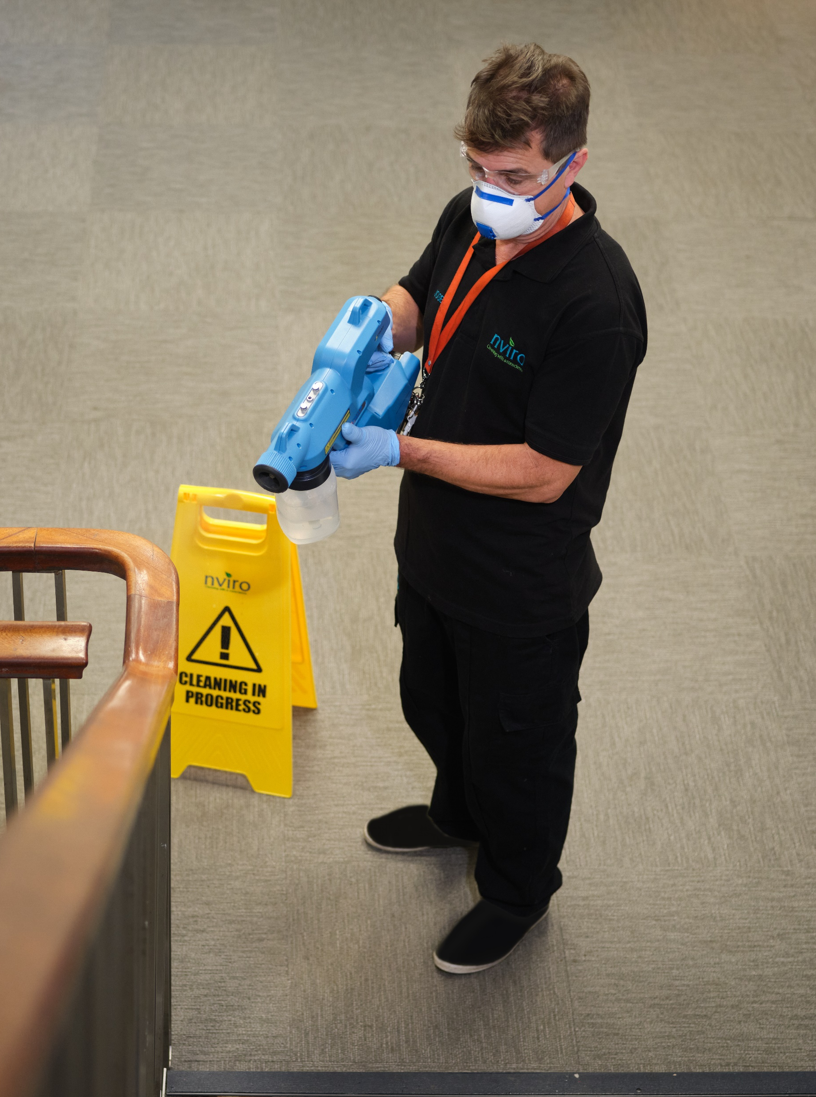
We’ll be using a protective coating to kill bacteria, viruses and germs..

Slide 11
Meaning that surfaces stay hygienic for longer

Slide 12
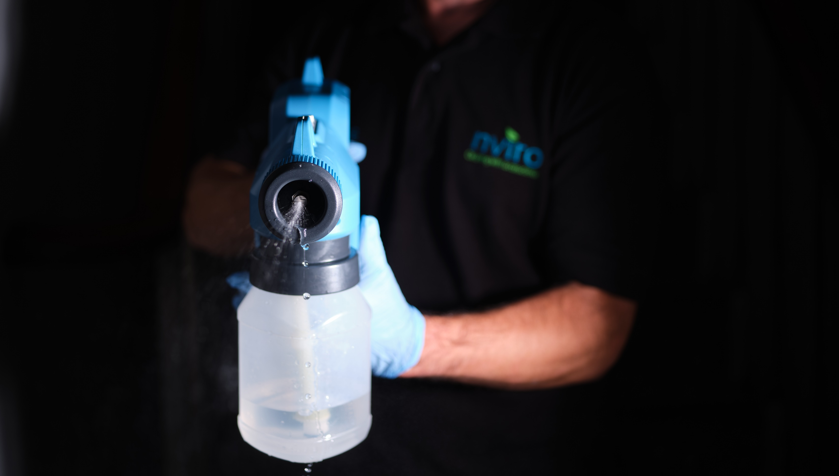
Why are we using protective coatings?

Slide 13
Protective Coatings Benefits
Kills bacteria, viruses and germs
Reduces sickness
Creates a healthier environment
Improves attendance

Slide 14
How can you help keep classrooms tidy?

Slide 15
Help keep classrooms tidy
Clear desks before you leave
Put rubbish in the centralised bins
Stack chairs at the end of the day
Keep floors clean and tidy

Slide 16
Please help us keep our school clean, hygienic and safe for us all to use

Slide 17
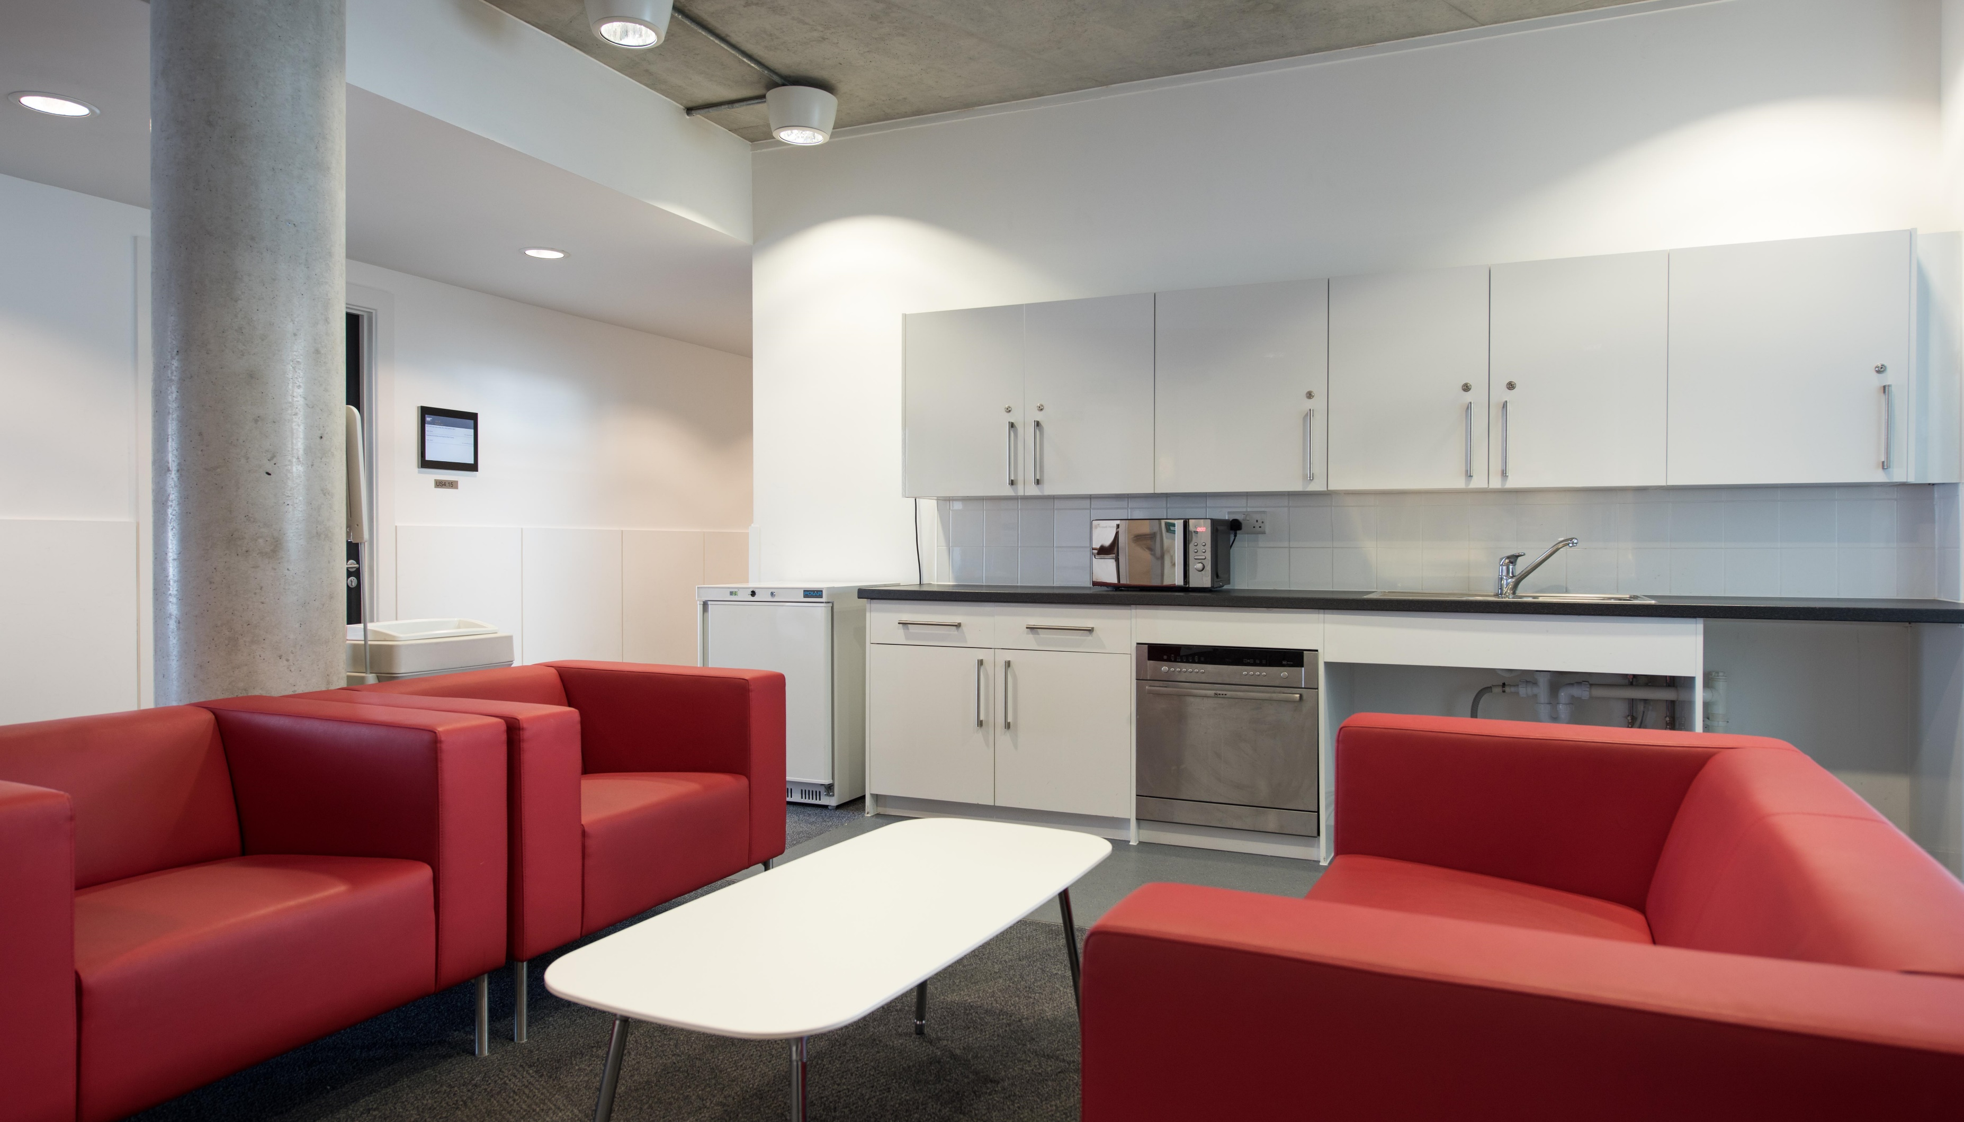
How can you help keep staff areas tidy?

Slide 18
Help keep staff areas tidy
Clear surfaces before you leave
Put rubbish in the bin
Put away used crockery
Wipe up any spills immediately

Slide 19
Please help us keep our school clean, hygienic and safe for us all to use

Slide 20
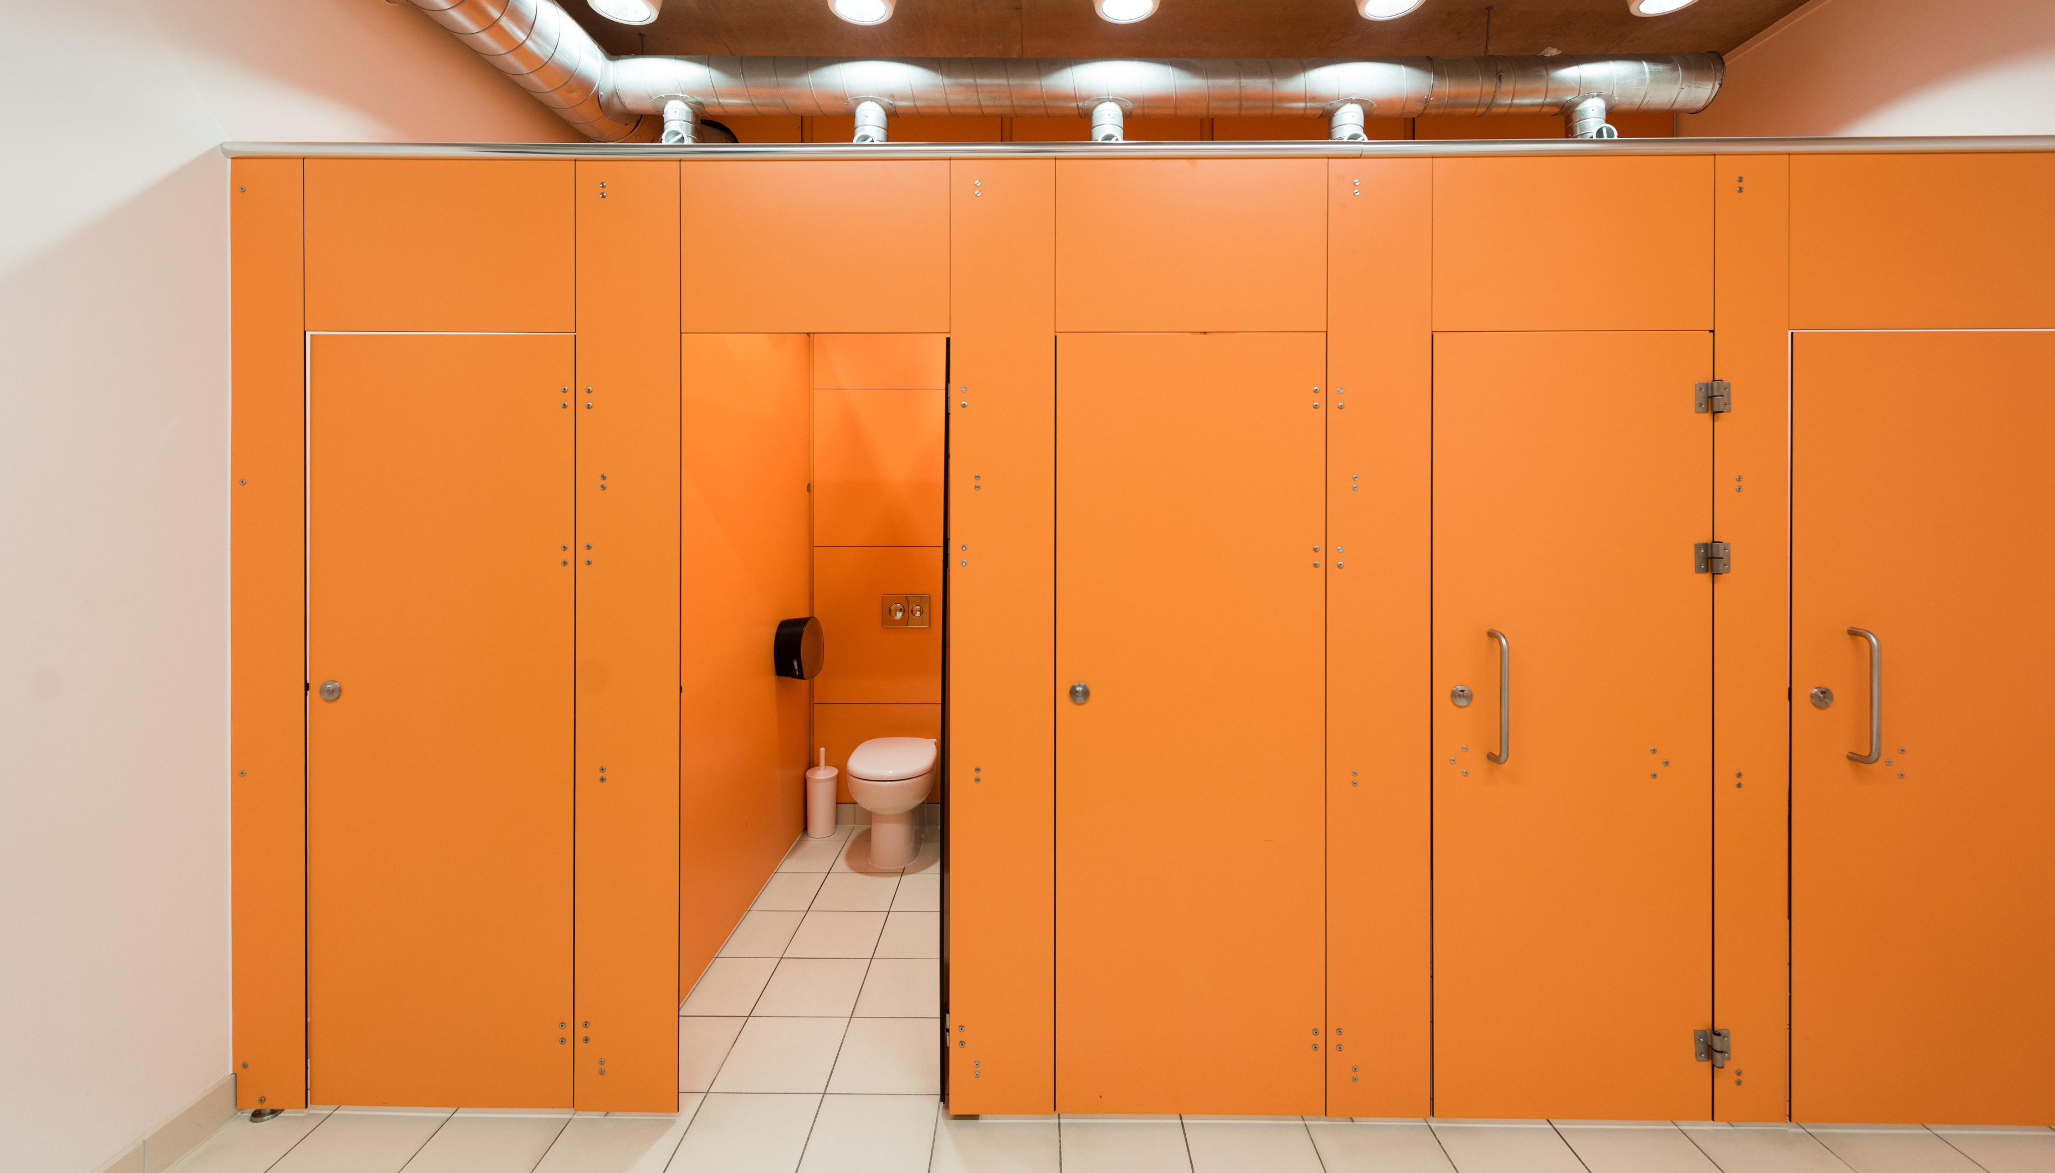
How can you help keep washrooms tidy?

Slide 21
Help keep Washrooms tidy
Flush the toilet thoroughly
Put paper towels in the bin
Only flush pee, poo and paper
Keep the floor dry and tidy

Slide 22
Please help us keep our school clean, hygienic and safe for us all to use

Slide 23
Insert logo
Changes to the way we clean your school

