Slide 1
Changes to the way we clean your University

Slide 2
We’re introducing a new hygiene solution to keep students, staff and building users safe

Slide 3
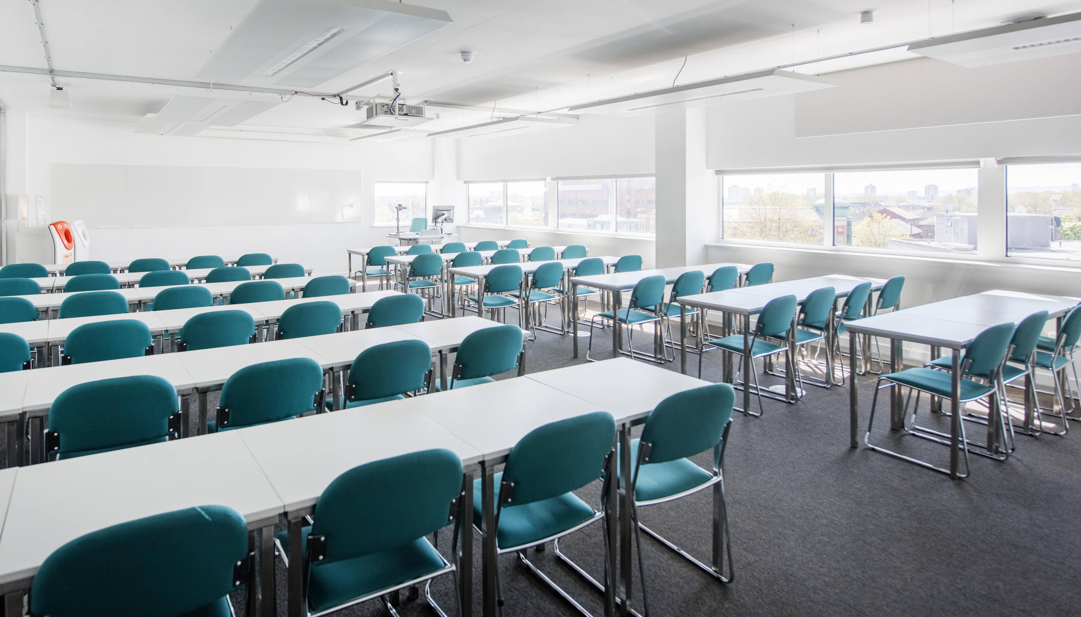
So, what’s changing?

Slide 4
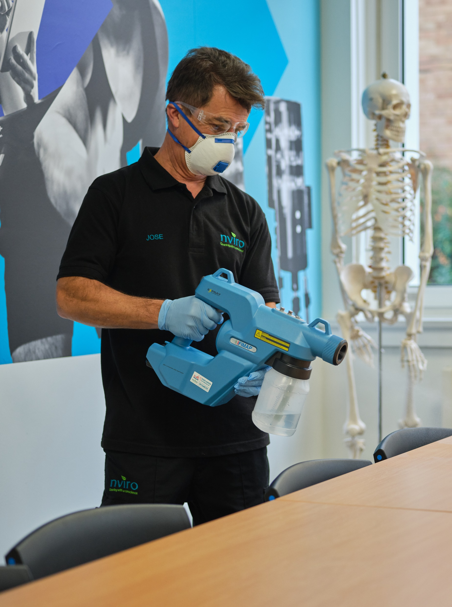
We will be using special coatings on surfaces to make them easier to keep clean

Slide 5
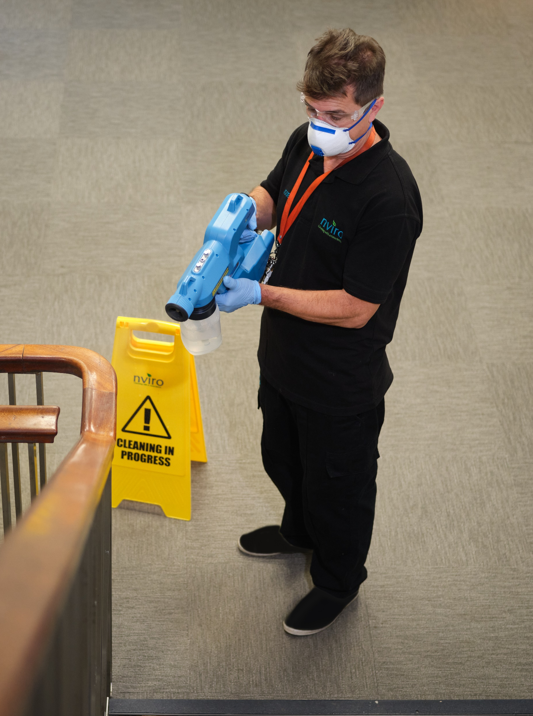
We will be using a protective coating to kill bacteria, viruses and germs

Slide 6
We will also be using swab testing to check hygiene levels

Slide 7
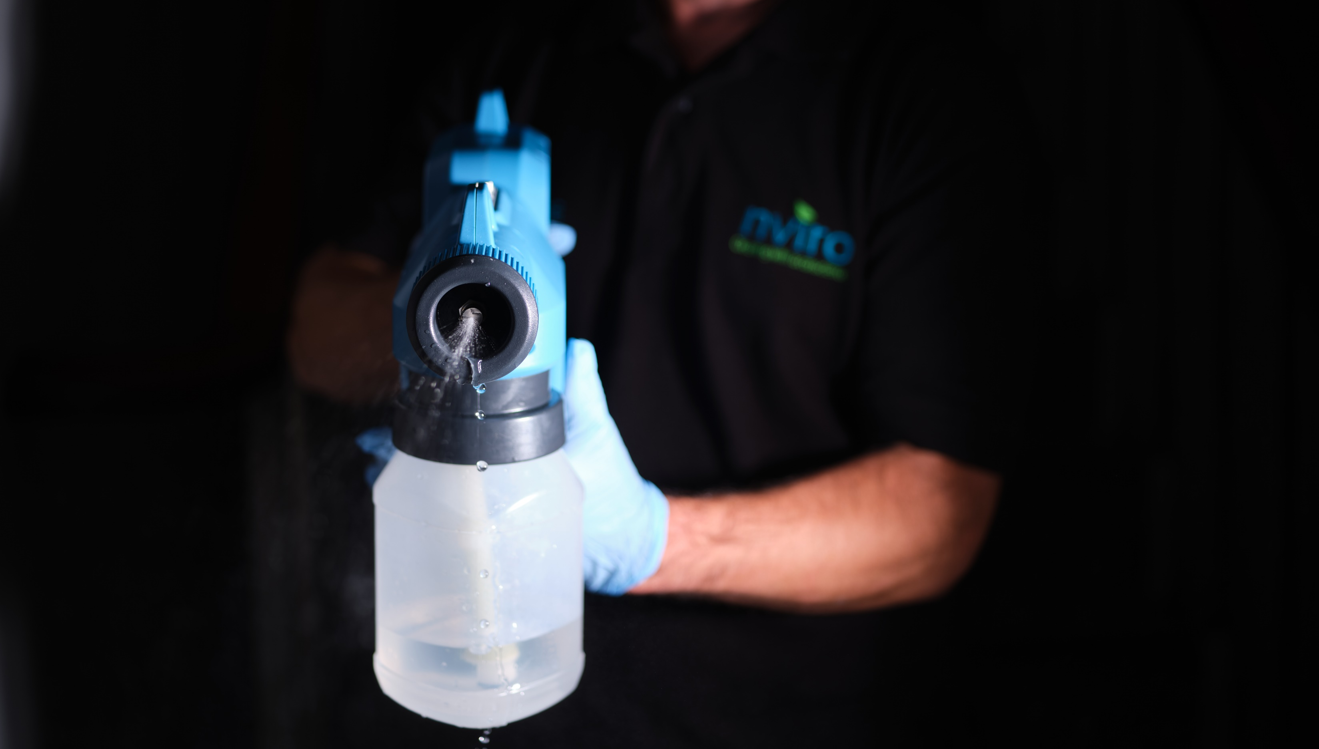
Why are we using protective coatings?

Slide 8
Protective Coatings Benefits
Kills bacteria, viruses and germs
Reduces sickness
Creates a healthier environment
Improves attendance

Slide 9
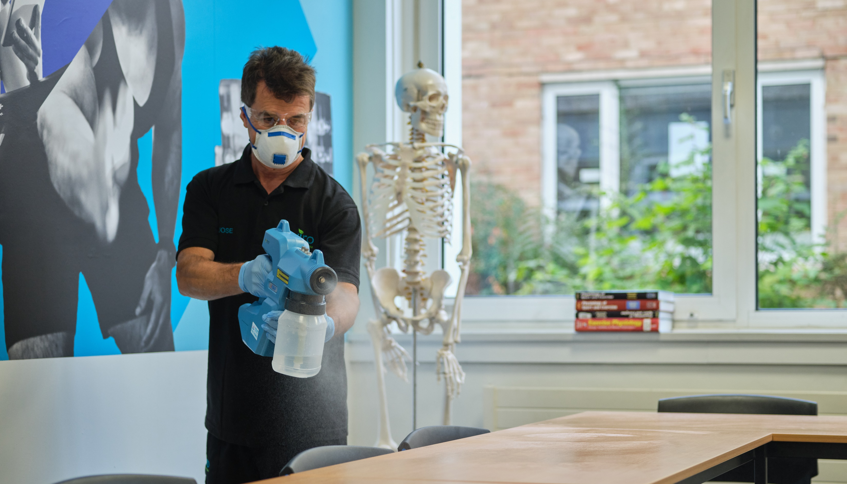
Why are we using surface enhancer?

Slide 10
Surface Enhancer Benefits
Long-term protection from contaminants
Enhances aesthetic appeal
Easier to clean
Prolongs the life of building fabric

Slide 11
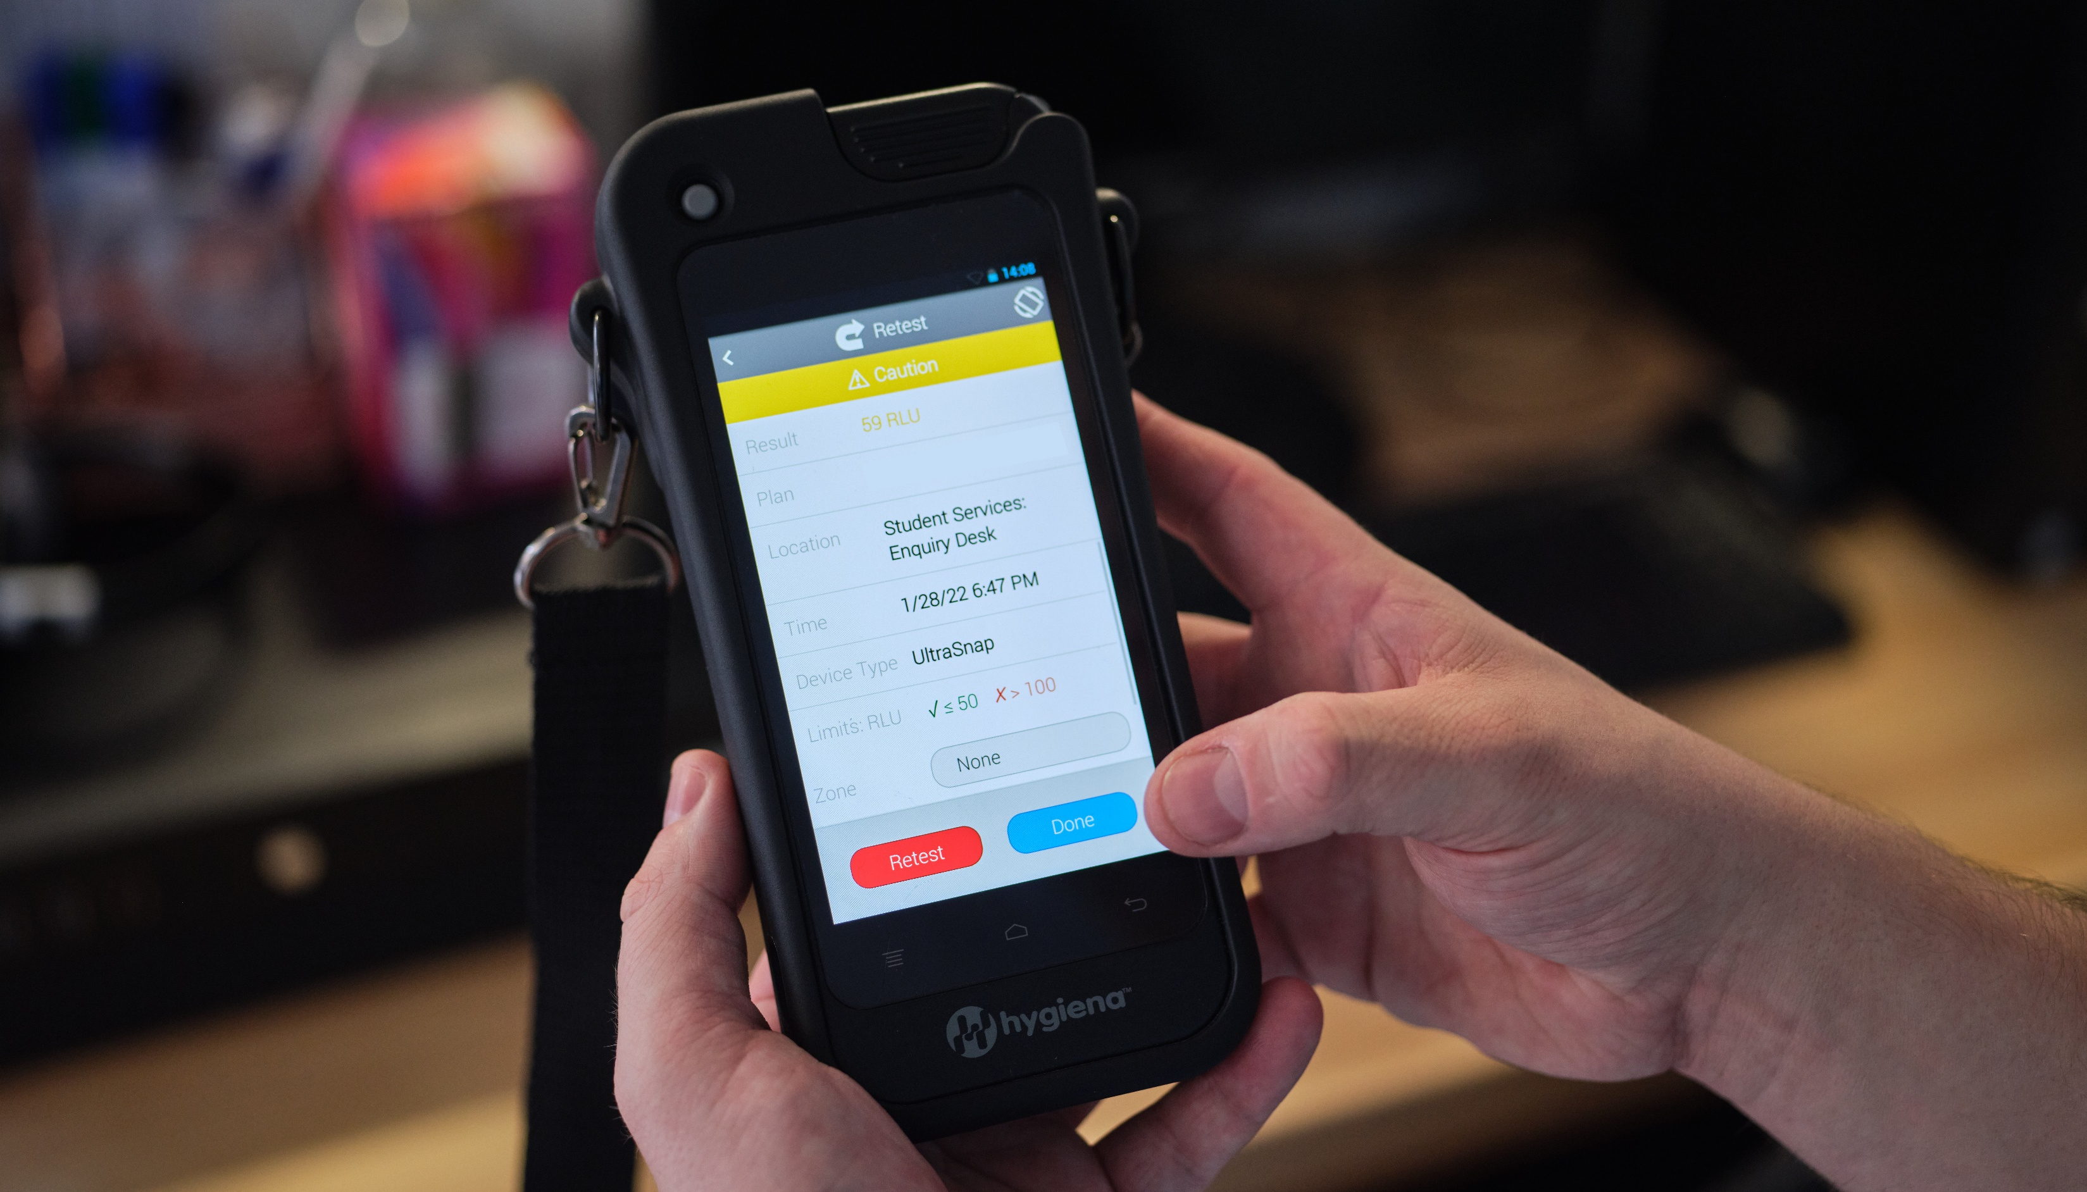
Why are we using swab testing?

Slide 12
Swab Testing Benefits
Identifies cleaning areas that can be improved
Reduces sickness
Improves attendance
Helps keep building users safe

Slide 13
Creating clean, hygienic and safe environments for building users to thrive in

Slide 14
Changes to the way we clean your University

